Slide 1

Geodemographic Analysis of Cities
Alex Singleton
Professor of Geographic Information Science
University of Liverpool

Slide 2
Overview
There are two main approaches to urban analytics: the variable and contextual paradigms.
What are Geodemographic classifications?
Geodemographics have a long history of use within cities.
How can Geodemographics be used to summarize population and built environment characteristics?

Slide 3
Variables v Contexts
Contexts are the social, environmental, and economic settings within which we live our lives
Evolve over multiple time scales
Places shape access to opportunity and frame who we are; there is a lengthy history of studies that explore such “neighborhood effects” (Sampson 2012)

Slide 4
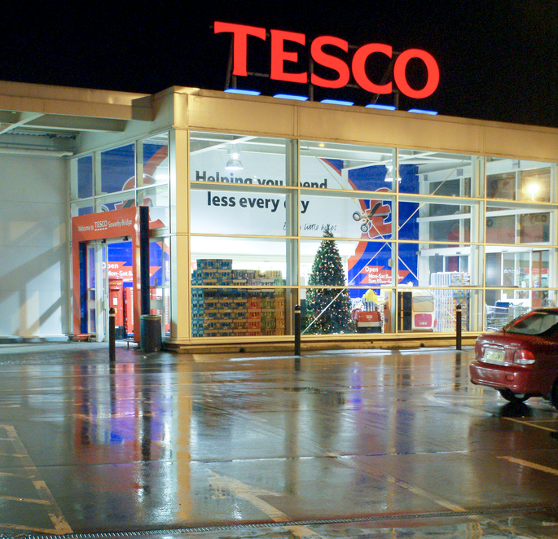
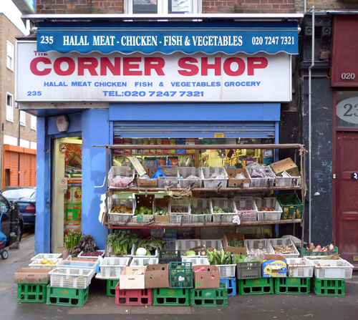
Supermarket
Local Shop
http://www.flickr.com/photos/adamkr/4191470438
http://www.flickr.com/photos/emilywebber/4327472686/

Slide 5

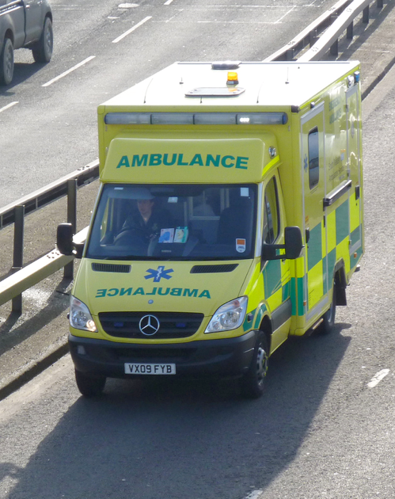
Sports Injury
Heart Problems
http://www.flickr.com/photos/dennymont/3165123595
http://www.flickr.com/photos/didbygraham/4295545485

Slide 6


Barbados
Blackpool
http://www.flickr.com/photos/rgtmum/467867963
http://www.flickr.com/photos/dgeezer/3808988864/

Slide 7

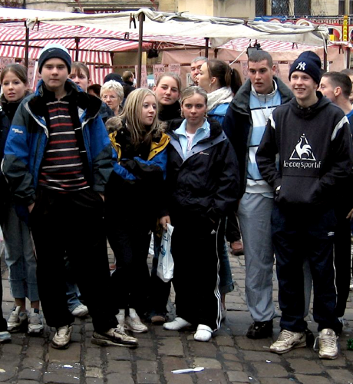
University
School
http://www.flickr.com/photos/iambigred/62451246

Slide 8
Variables v Contexts
A variables mode of inquiry seek to assess the influence of an abstract concept (e.g. as wealth or education) on some sort of outcome of interest.
A contextual mode of analysis sees neighborhoods as bundles of variables that are difficult to separate
Neighborhood-to-neighborhood differences are conceptualized as changes of type, rather than increments to variables, and additionally are more prevalently descriptive rather than explanatory.
Two types
Continuous measure of the constructs that they are designed to assess (see Lecture 10)
A categorical classification technique that is prevalently referred to as geodemographics

Slide 9

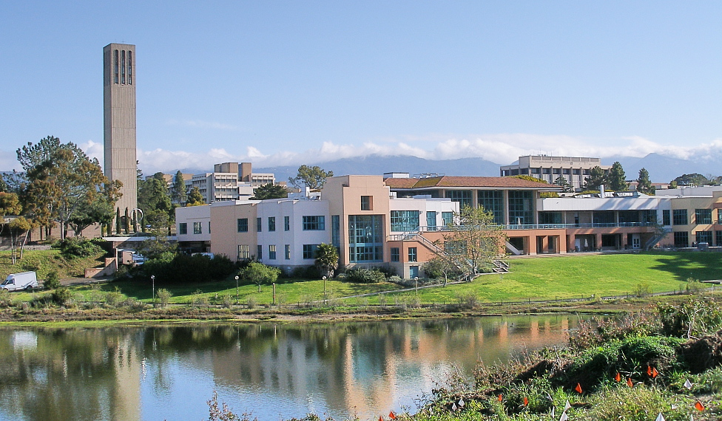
First Law of Geography
"Everything is related to everything else, but near things are more related to each other”
http://en.wikipedia.org/wiki/University_of_California,_Santa_Barbara
Waldo Tobler in front of the Newberry Library. Chicago, November 2007 (http://en.wikipedia.org/wiki/Waldo_R._Tobler)

Slide 10
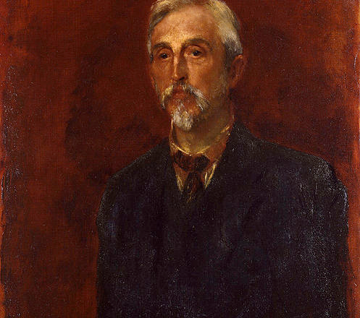
Charles Booth
Charles Booth
30 March 1840 – 23 November 1916
Shipping business owner & Philanthropist
Survey:
“Life and Labour of the People in London”
First Edition
Life and Labour of the People, Vol. I (1889)
Labour and Life of the People, Vol II (1891)
Second Edition
Life and Labour of the People in London; 9 volumes 1892-97
Third Edition
Life and Labour of the People in London; 17 volumes (1902-03)
Quantitative and Qualitative
http://en.wikipedia.org/wiki/File:Charles_Booth_by_George_Frederic_Watts.jpg

Slide 11
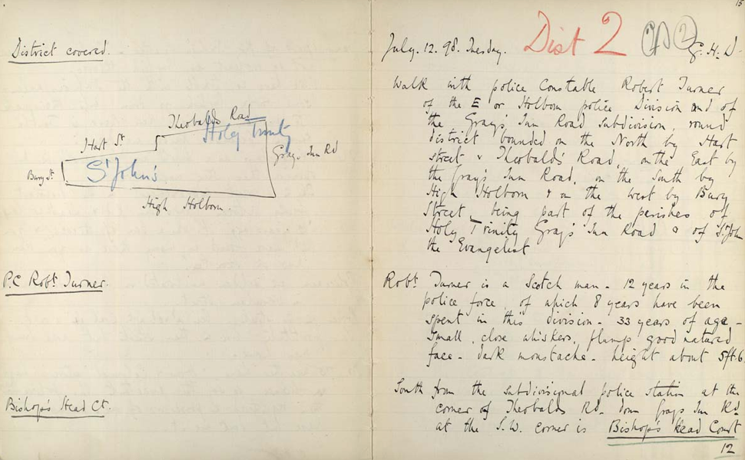
Walk with Police Constable Robert Turner, 12 July 1898
http://booth.lse.ac.uk

Slide 12
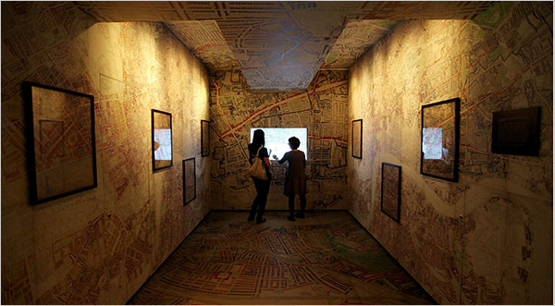
http://www.nytimes.com/2010/05/24/arts/24iht-design24.html

Slide 13
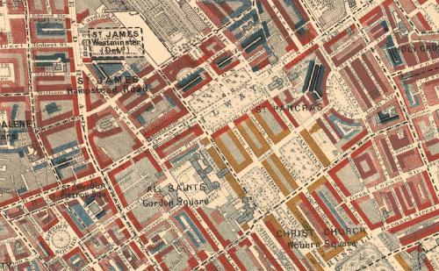
Description
BLACK: Lowest class. Vicious, semi-criminal.
DARK BLUE: Very poor, casual. Chronic want.
LIGHT BLUE: Poor. 18s. to 21s. a week for a moderate family
PURPLE: Mixed. Some comfortable others poor
PINK: Fairly comfortable. Good ordinary earnings.
RED: Middle class. Well-to-do.
YELLOW: Upper-middle and Upper classes. Wealthy.

Slide 14
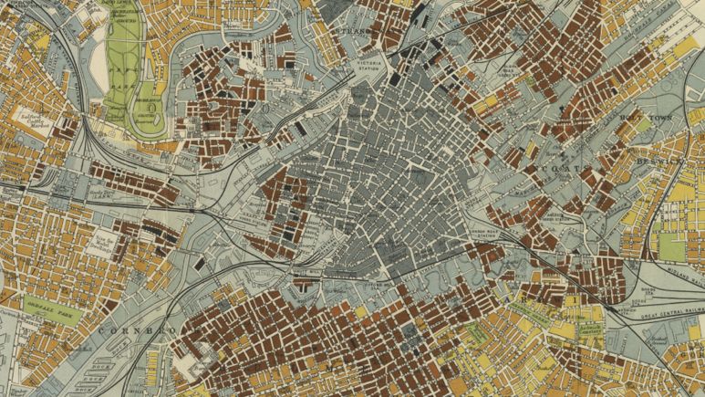
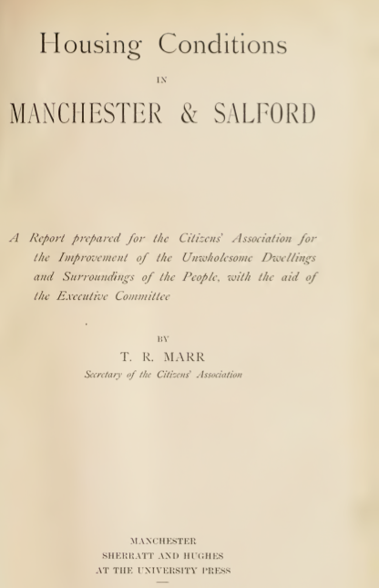
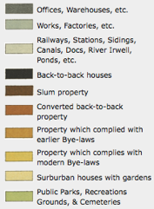
Marr, T.R. (1904) Housing Conditions in Manchester and Salford. Manchester, Manchester University Press.

Slide 15
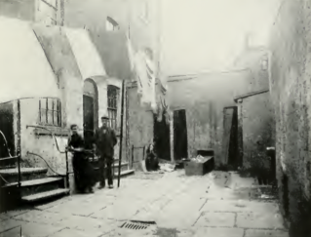
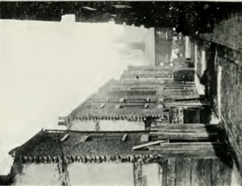
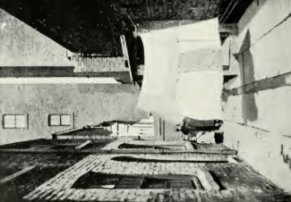
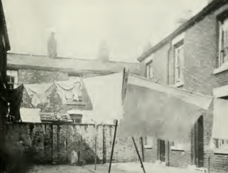
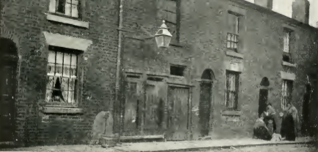

Slide 16
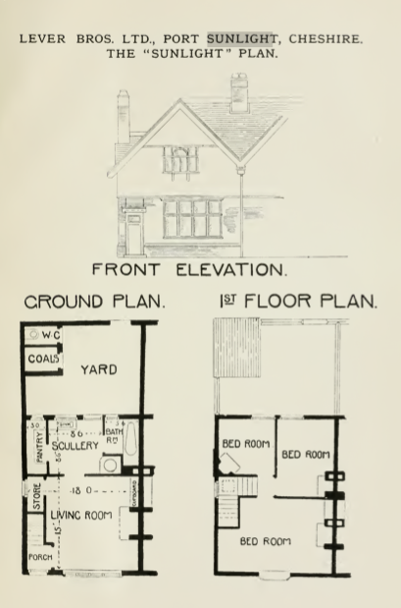
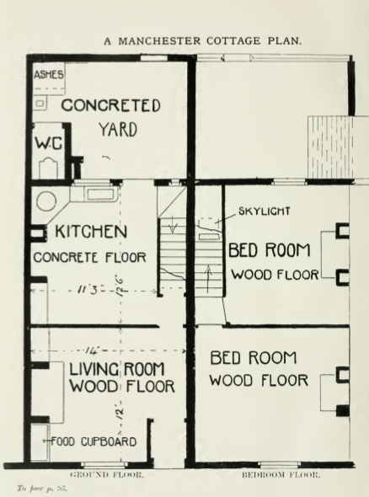

Slide 17


Slide 18
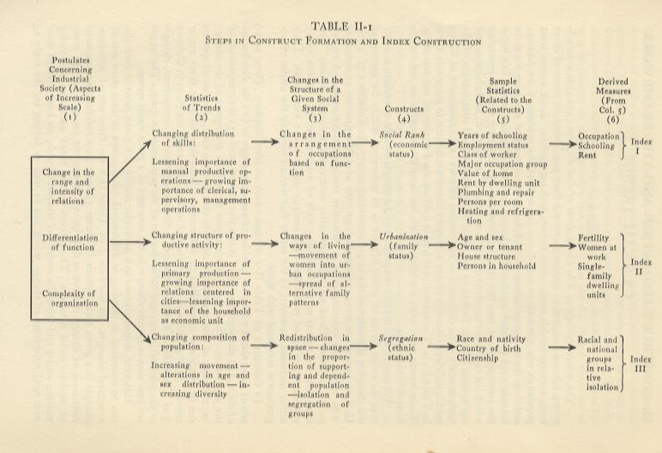
Social Area Analysis

Slide 19
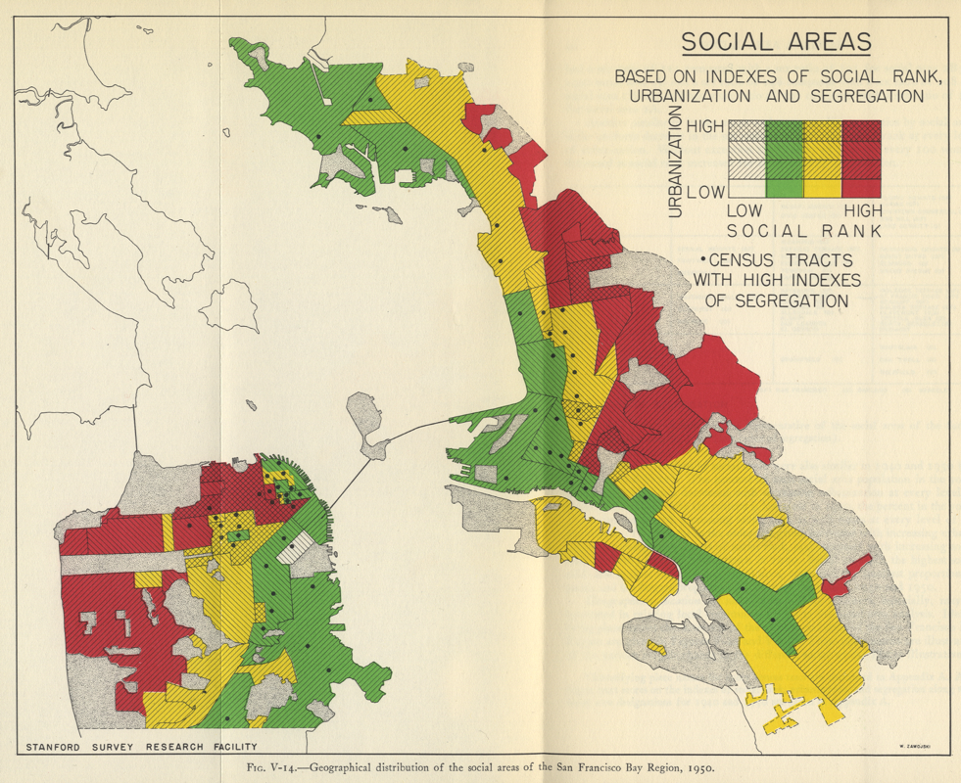

Slide 20


Slide 21
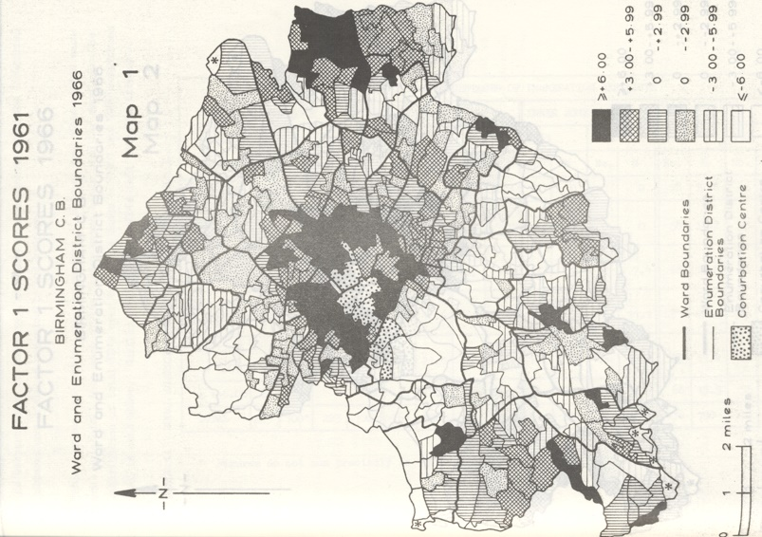
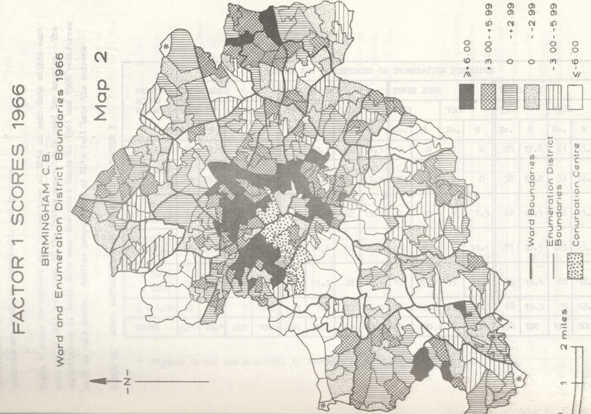
Lower Scores = higher class

Slide 22
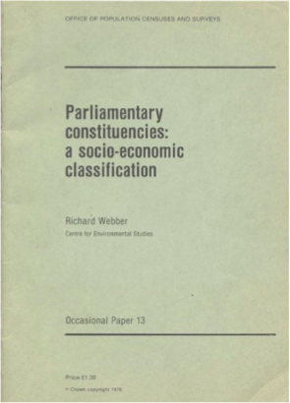
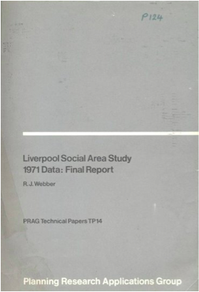

Origins of Geodemographics
Technique developed in 1970’s attributed to Richard Webber
Identify similar neighborhoods
Target urban deprivation Funding
Public Sector – Government
Enumeration District Level
Moved to CACI
Linked ED to Postcode
ACORN (Private Sector)
Moved to Experian
MOSAIC (Private sector)

Slide 23
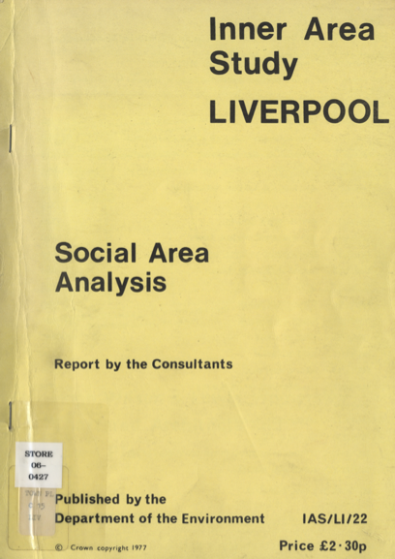

Slide 24
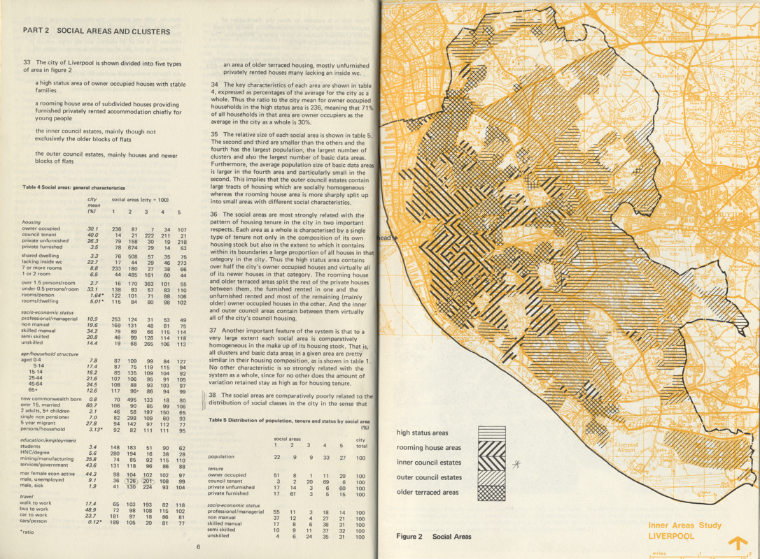

Slide 25
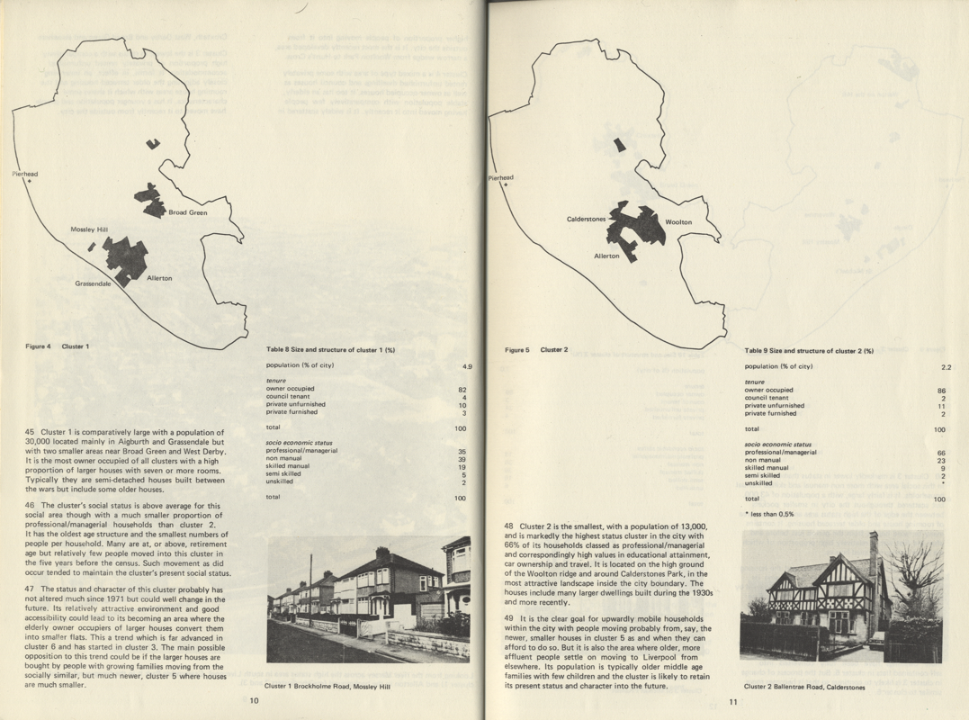

Slide 26
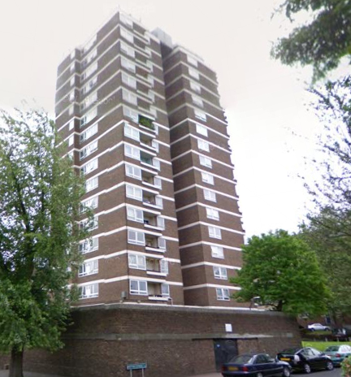
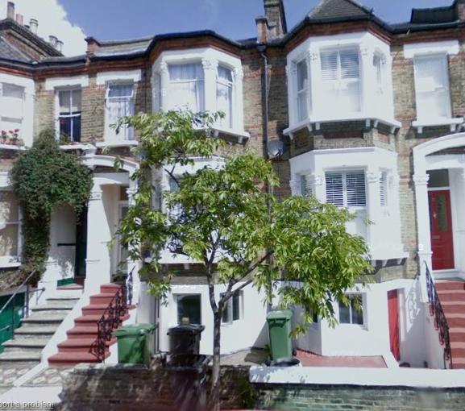
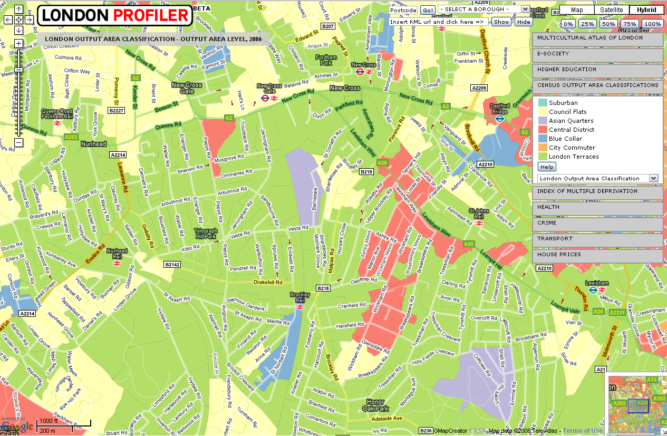
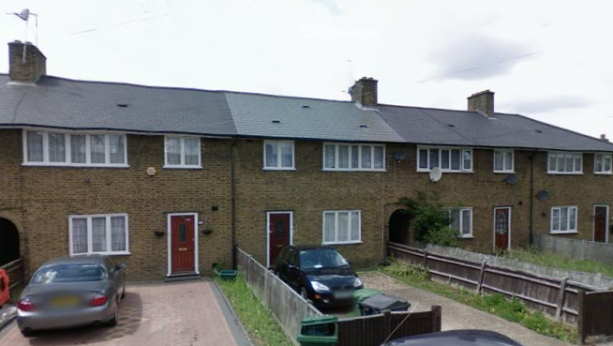
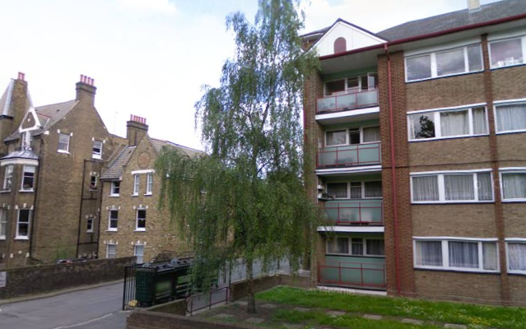

Slide 27
London Terraces
Council Flat
Blue Collar
Central Districts

Slide 28
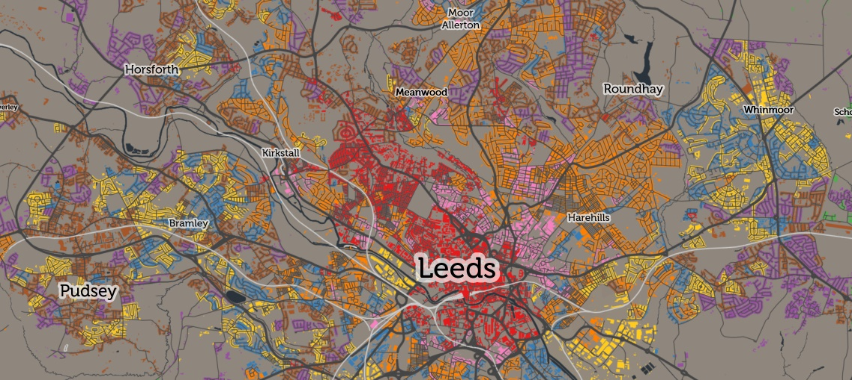
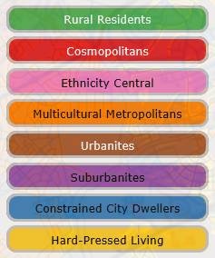
General Purpose Geodemographics
https://maps.cdrc.ac.uk/#/geodemographics/oac11

Slide 29
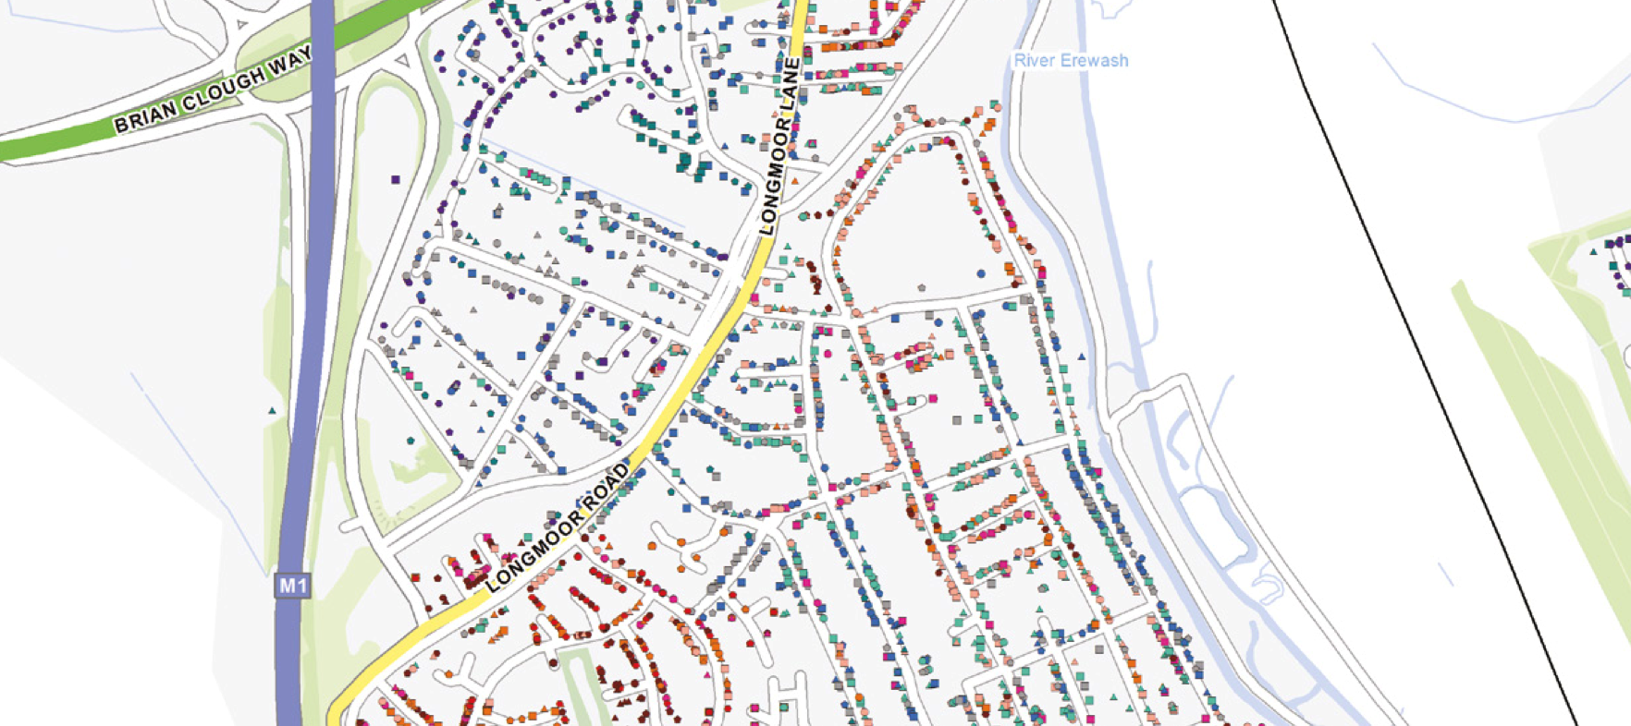
General Purpose Geodemographics
https://www.experianintact.com/content/uk/documents/productSheets/MosaicConsumerUK.pdf

Slide 30
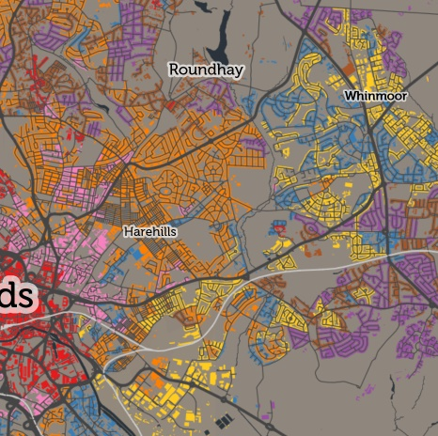
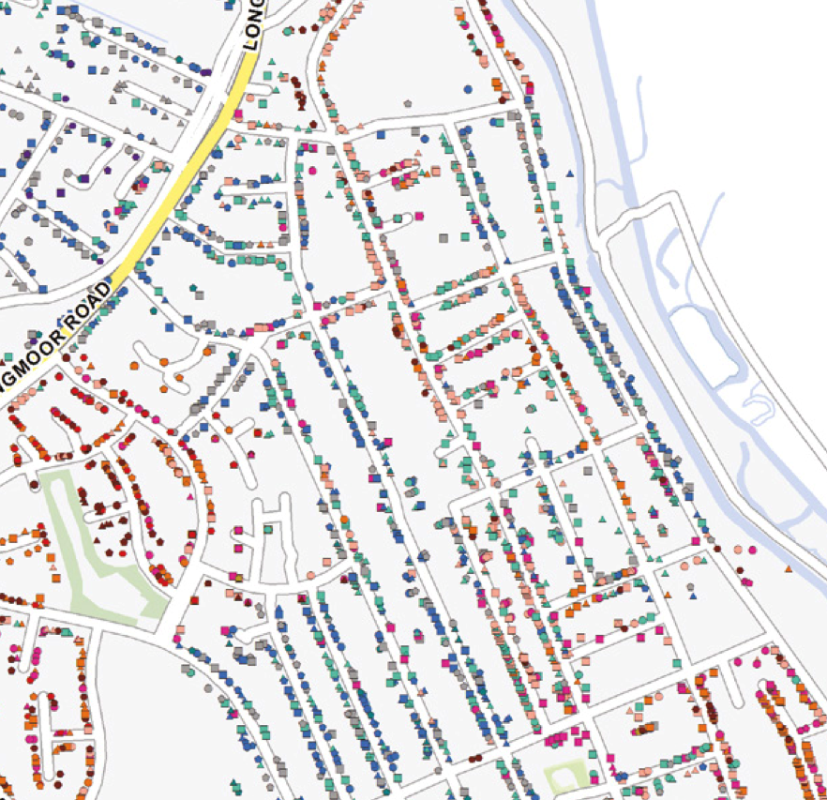
Open V Closed

Slide 31
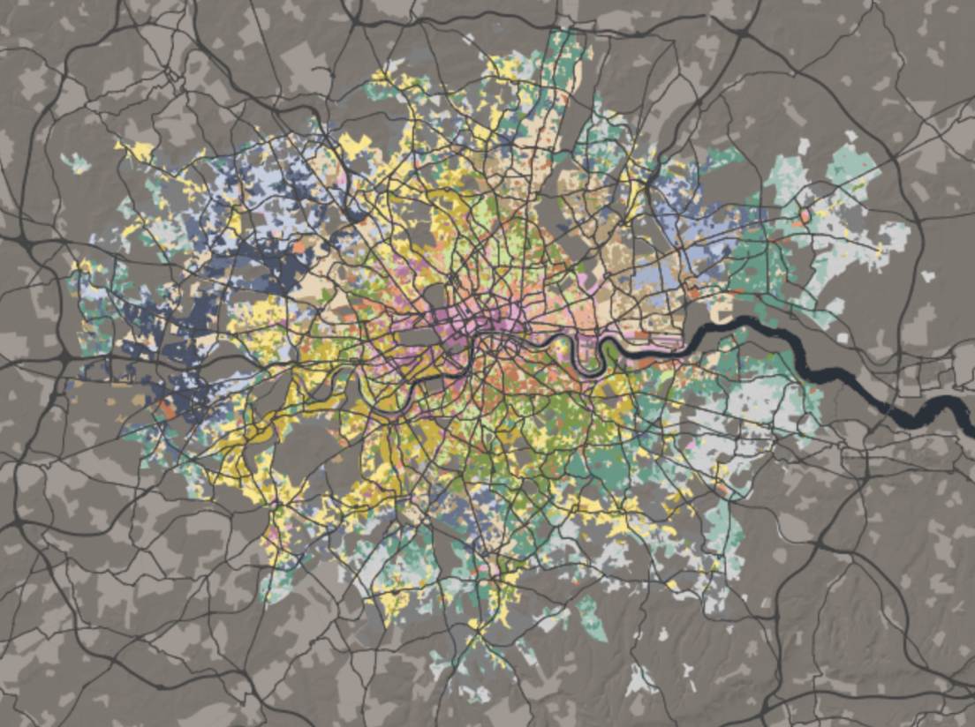
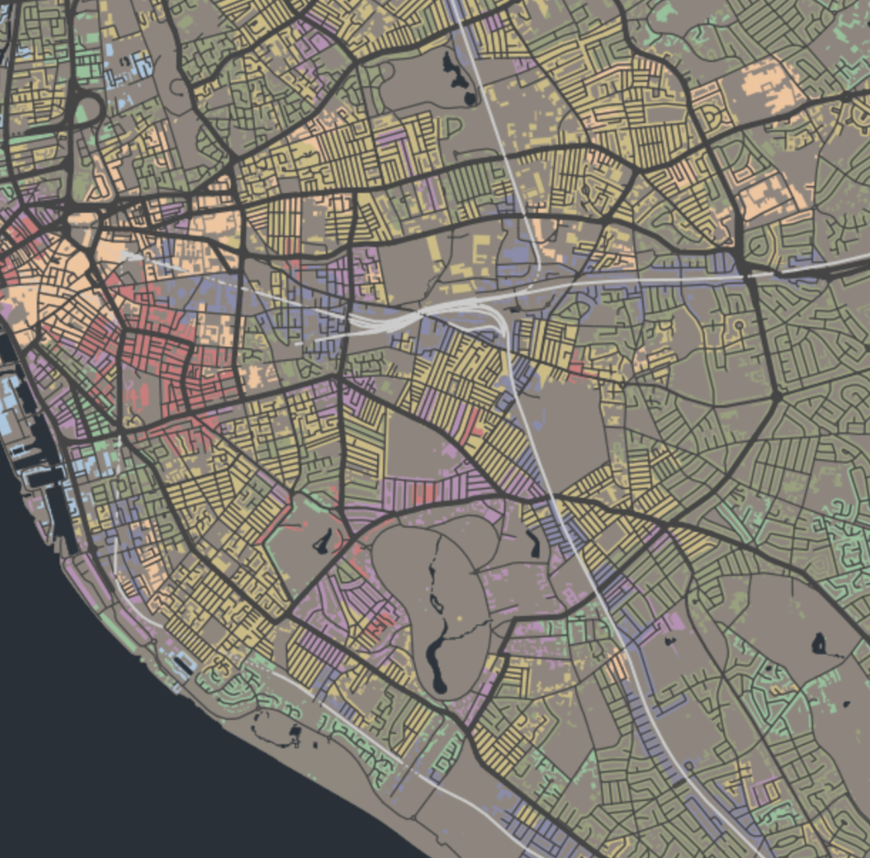
What are bespoke classifications?
By area…
By topic…

Slide 32
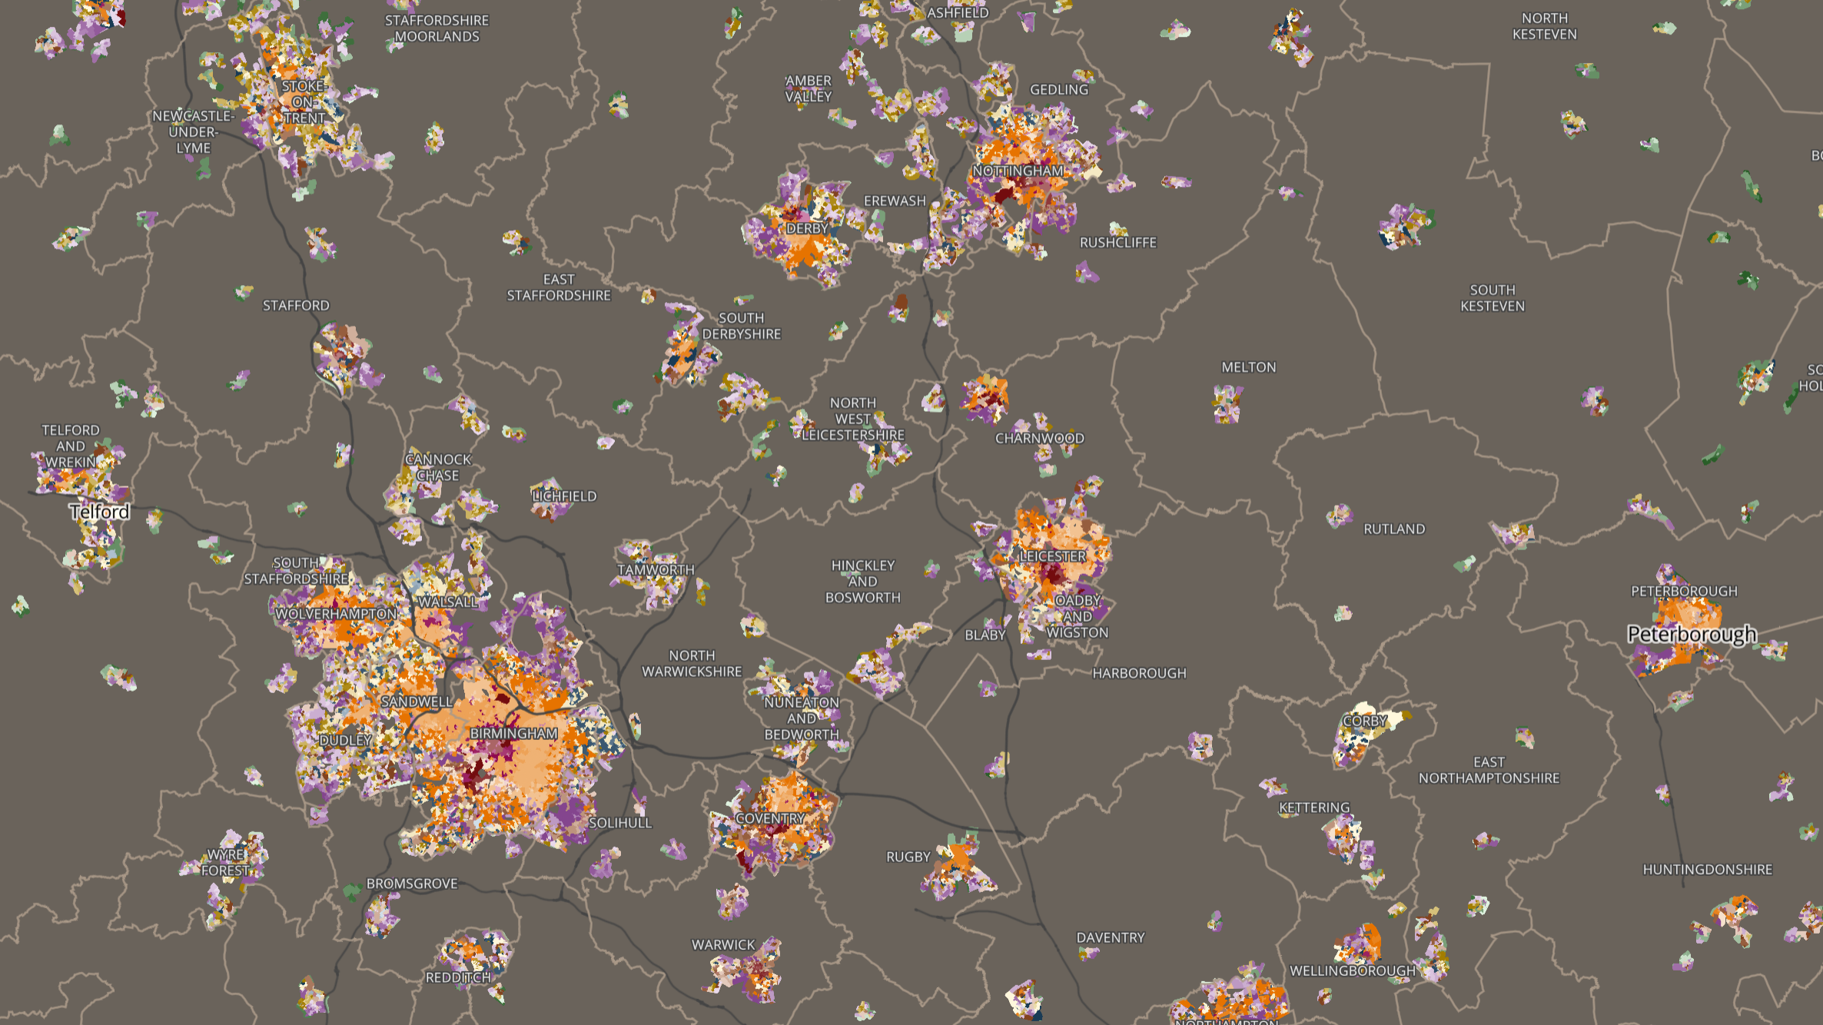
Building a Geodemographic

Slide 33
Theoretical Framework

Slide 34
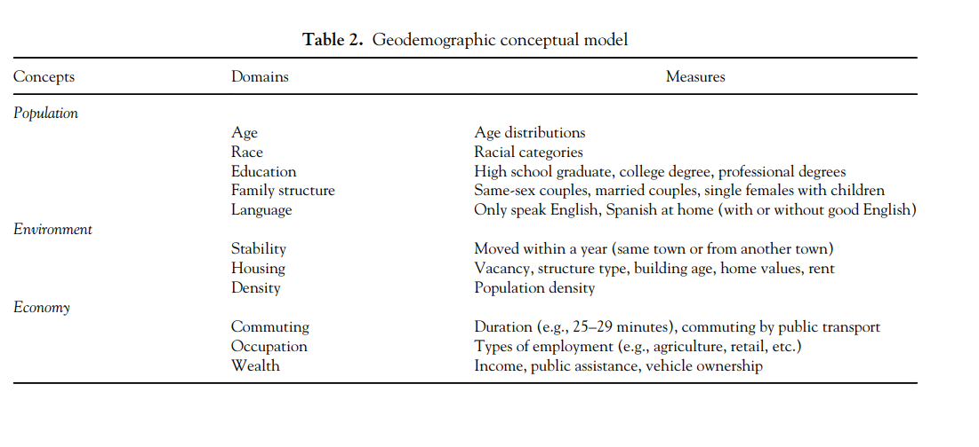
Theoretical Framework
https://doi.org/10.1080/00045608.2015.1052335

Slide 35
Data
Area | V1 | V2 | V3 | V4 | V5 | V6 | V7 | V8 | V9 | V10 | ...
Area1
Area2
Area3
Area4
Area5
Area6
Area7
Area8
...

Slide 36
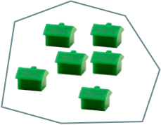

Data
Non Census Data
Census Data
Resolution: Person - Large Area
Coverage: Variable
Resolution: Output Area
Coverage: 100%

Slide 37
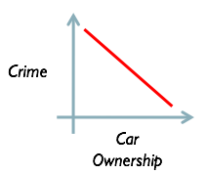
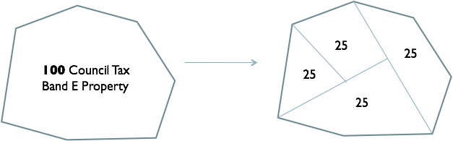
Data Modelling
Survey data
Model outcomes for whole population based on “small” samples.
Imputing small area characteristics from larger area statistics...e.g....
Standardize / Normalize

Slide 38
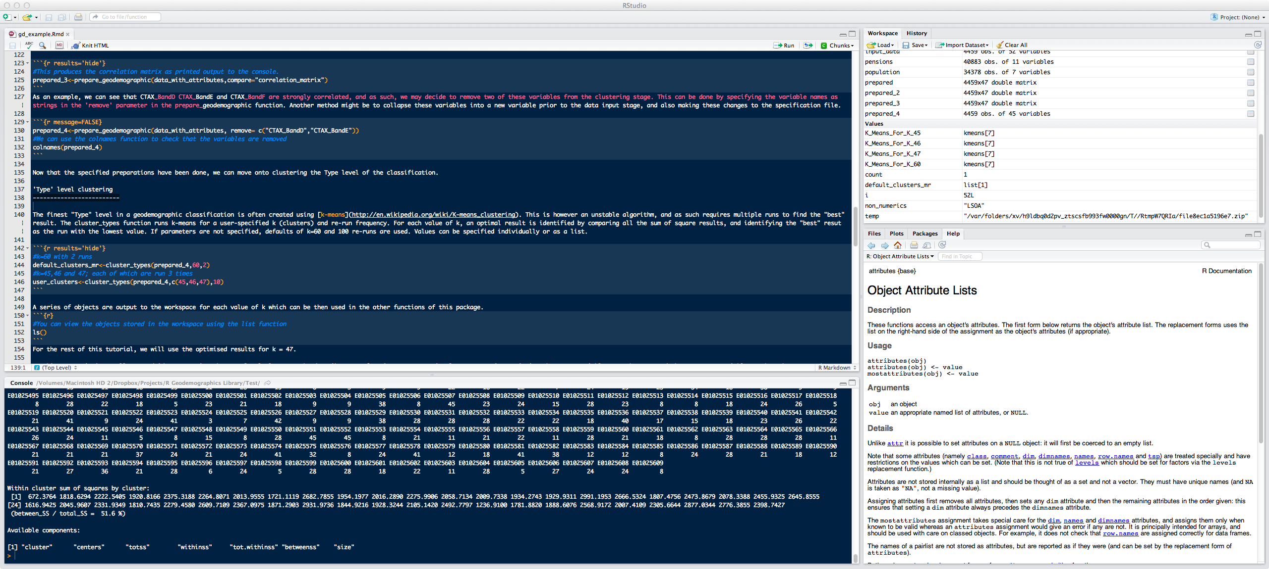
Cluster Analysis

Slide 39
Cluster Analysis
Variable 2
Cluster 1
Cluster 2
Variable 1
Cluster 3

Slide 40
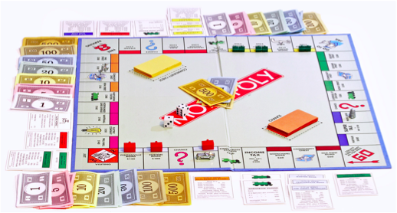
Output
Area | Cluster
Area1 | 1
Area2 | 1
Area3 | 2
Area4 | 1
Area5 | 3
Area6 | 3
Area7 | 3
Area8 | 2
...

Slide 41
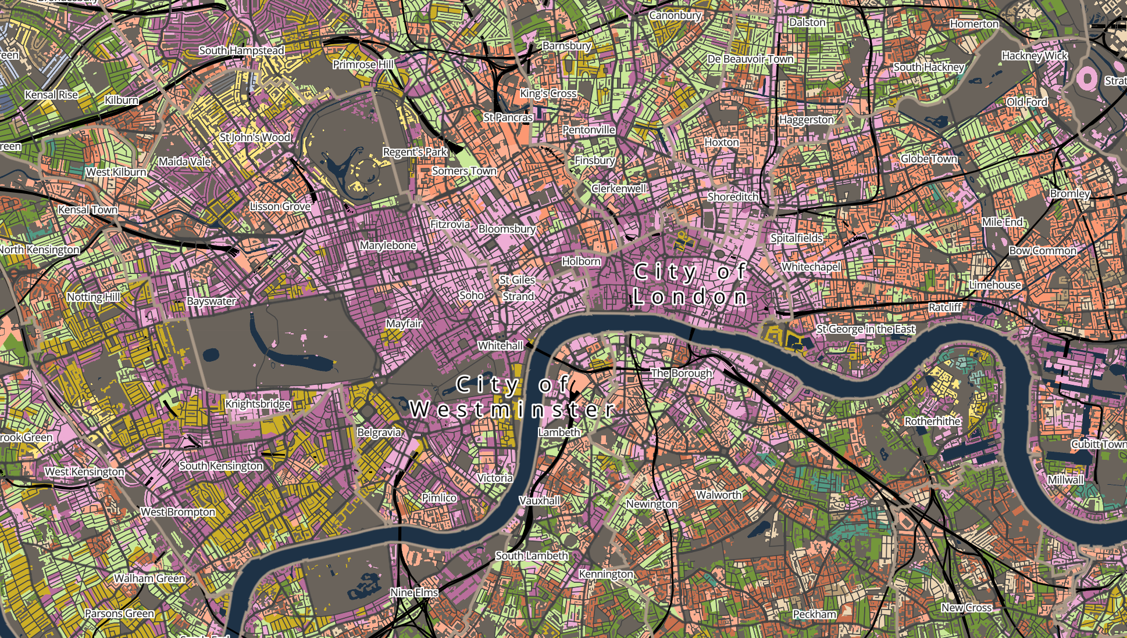
Example Geodemographics

Slide 42

Experian: Mosaic
440 Variables
62% Experian Data
38% Census Estimates
67 Types
15 Groups

Slide 43
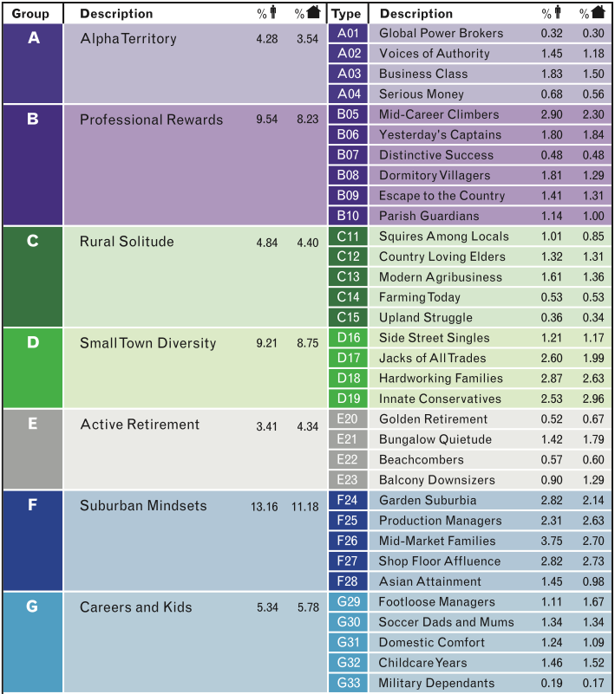
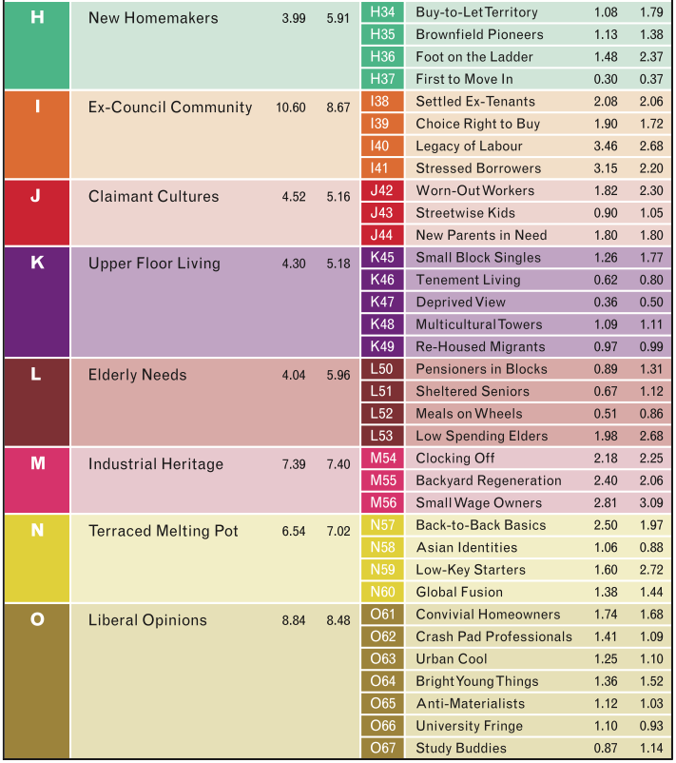

Slide 44


Slide 45


Slide 46


Slide 47

Acorn
440 Variables
70% CACI Data
30% 2001 Census
5 Categories
17 Groups
56 Types

Slide 48

Input Data

Slide 49



Slide 50


Slide 51


Slide 52

P²
100% Census Data
13 Trees
40 Branches
156 Leaves
Regional
London and the M25
England and Wales
(excluding London and the M25)
Scotland
Northern Ireland

Slide 53



Slide 54



Slide 55


Slide 56


Slide 57

Future Geodemographics

Slide 58
Hybrid Geodemographics
Inputs
Output
Open
Data
Secure
Setting
Open
Product
Model Building
Small area
Estimates
Survey
Data
Controlled
Product
Retailers Data
Controlled
Setting
Controlled
Setting
Blended Approach

Slide 59

Digital Exclusion / Inclusion
https://www.ons.gov.uk/peoplepopulationandcommunity/householdcharacteristics/homeinternetandsocialmediausage/articles/exploringtheuksdigitaldivide/2019-03-04

Slide 60

Digital Exclusion / Inclusion
Digital by Default aims to transform public services online
Part of the coalition government (2012)
Marth Lane Fox (Digital Champion)
Directgov 2010 and beyond: revolution not evolution

Slide 61



Digital Exclusion / Inclusion
https://vote.conservatives.com/our-plan

Slide 62

Framework

Slide 63

Framework
Creates representative weights
Fixes some issues with missing values
IPFP: Iterative Proportional Fitting Procedure

Slide 64

Variables common between the 2011 Census and the BPS

Slide 65
Framework
Creates representative weights
Fixes some issues with missing values
Extreme Gradient Boosting
IPFP: Iterative Proportional Fitting Procedure

Slide 66

XGBoost Output
Independent variable importance (1.0 being the most influential) for the final model predicting “Buy Groceries Online”.

Slide 67
Framework
Creates representative weights
Fixes some issues with missing values
Extreme Gradient Boosting
IPFP: Iterative Proportional Fitting Procedure

Slide 68
Internet User Classification

Slide 69


Internet User Classification
https://maps.cdrc.ac.uk/#/geodemographics/iuc18/

Slide 70
e-Professionals

Slide 71
e-Professionals
The e-Professionals Group have high levels of Internet engagement, and comprises fairly young populations of urban professionals, typically aged between 25 and 34. They are experienced users and engage with the Internet daily and in a variety of settings. While communication and entertainment activities are very common, they tend to favour entertainment, such as gaming, more than social networks. They also carry out a significant portion of shopping activities online, particularly for non-groceries, and they use a variety of devices and methods to access the Internet. This Group is ethnically diverse, with a very strong representation of white, non-British populations. They are well-qualified and have very high availability of Internet at work. This Group tends to be found in residential areas abutting city centres or within affluent suburbs.

Slide 72
Settled Offline Communities

Slide 73
Settled Offline Communities
Most members of this Group are elderly, White British and retired, and tend to reside in semi-rural areas. They undertake only limited engagement with the Internet (Figure 12), they may have only rare access or indeed no access to it at all. Any online behaviour tends to be through home computers rather than mobile devices, and is focused upon information seeking and limited online shopping (particularly for more bulky items such as white goods) rather than social networking, gaming or media streaming.

Slide 74



Slide 75

Census 2021…

Slide 76
Census 2021
100k Households located in 7 LAD; alongside a further 108,000 randomly selected households across the rest of England and Wales

Slide 77


Slide 80
Hybrid Geodemographics
Hybrid geodemographics enable a way that services like the CDRC can widen access to consumer data
There is a wealth of data on digital inclusion / exclusion
Such classifications can provide real world insight

Slide 81
Conclusion
Introduced Geodemographic classification as an example of the contextual paradigm in urban analytics
Outlined how a Geodemographics can be created
Provided examples of commercial geodemographics
Illustrated how “hybrid Geodemographics” can bridge open and closed classifications to create new insights

